Slide 1

HUMAN VALUES AND PROFESSIONAL ETHICS
GROUP -9
19131A05K7- S.BHAVITHA
19131A05M3- S.FIROZA
19131A05N7- T.HIMA BINDU
19131A05P1- B.V.S.S.L. GAYATHRI
19131A05P7- M.VANDANA
19131A05P9- V.GREESHMA

Slide 2
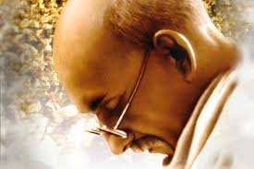
WHAT WAS MAHATMA GANDHI’S VIEW ON ETHICS?
Some of the ethical teachings of the Gandhi are
Non-Violence
Truth
Non-stealing
Celibacy
Non-possessiveness
Character
Life Moral Teachings.

Slide 3
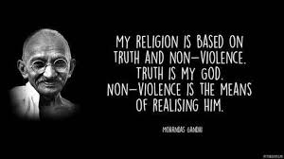
WHAT IS GANDHIAN THEORY?
Gandhian is a body of ideas that describes the inspiration, vision and the life work of Mohandas Gandhi.
The two pillars of Gandhism are TRUTH and NON-VIOLNCE.
The term "Gandhism" also encompasses what Gandhi's ideas, words, and actions mean to people around the world and how they used them for guidance in building their own future. Gandhism also permeates into the realm of the individual human being, non-political and non-social.

Slide 4
More than ever before, Mahatma Gandhi's teachings are valid today, when people are trying to find solutions to the rampant greed, widespread violence, and runaway consumptive style of living
Truth, nonviolence, Sarvodaya and Satyagraha and their significance constitute Gandhian philosophy and are the four pillars of Gandhian thought

Slide 5
LINK BETWEEN SATYAGRAHA AND SWARAJ
Swaraj lays stress on governance not by a hierarchical government, but self governance through individuals and community building.
Gandhi explains “It is Swaraj when we learn to rule ourselves”.
The word ‘Satya’ means ‘Truth’ and ‘Graha’ means ‘Force’, Satyagraha therefore means ‘Truth force’ or the force obtained by the practice of truth.
The essential elements of Satyagraha are civil-disobedience and non-cooperation as a means to attain freedom.

Slide 6
For freedom to the achieved, it has to be through a non-violent ways. He viewed it as a relationship between a mother and an offspring. Swaraj being the mother and satyagraha the offspring is inseparable.

